Slide 1
Why Cybersecurity Is Hard
The Community Forum Session at Cybersecurity Days
Dr. Zhiqiang Lin
Professor of Computer Science & Engineering
The Ohio State University
10/13/2021

Slide 2
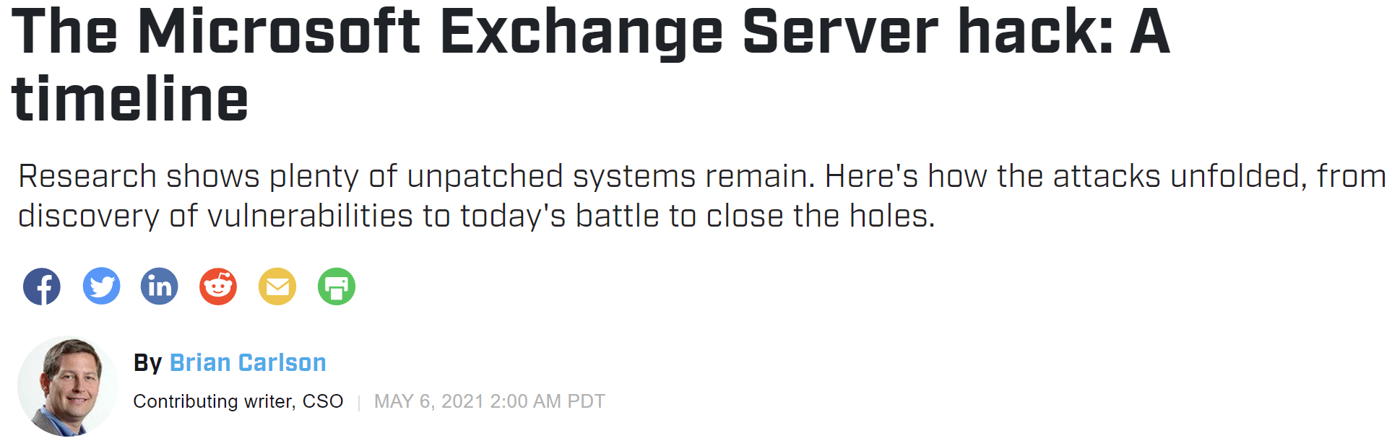
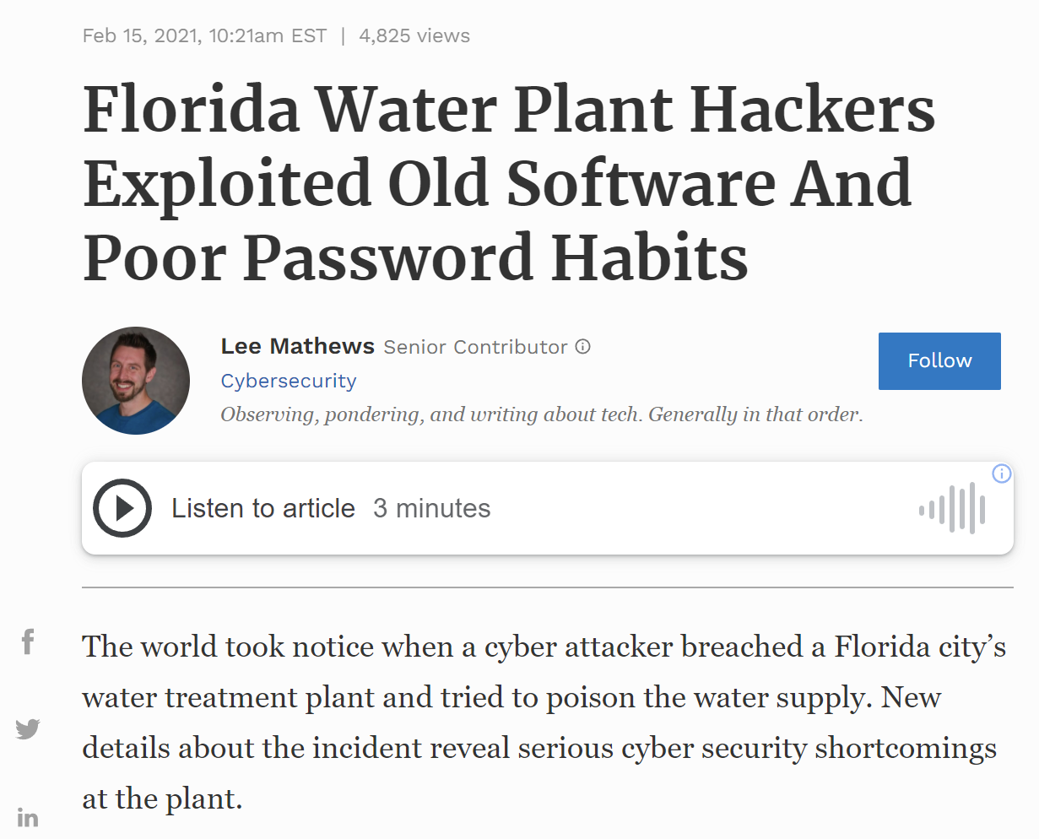
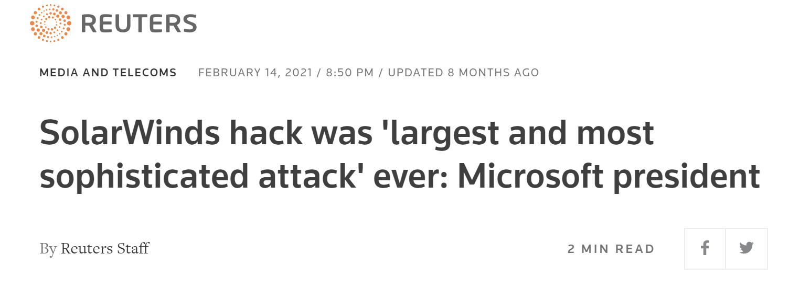
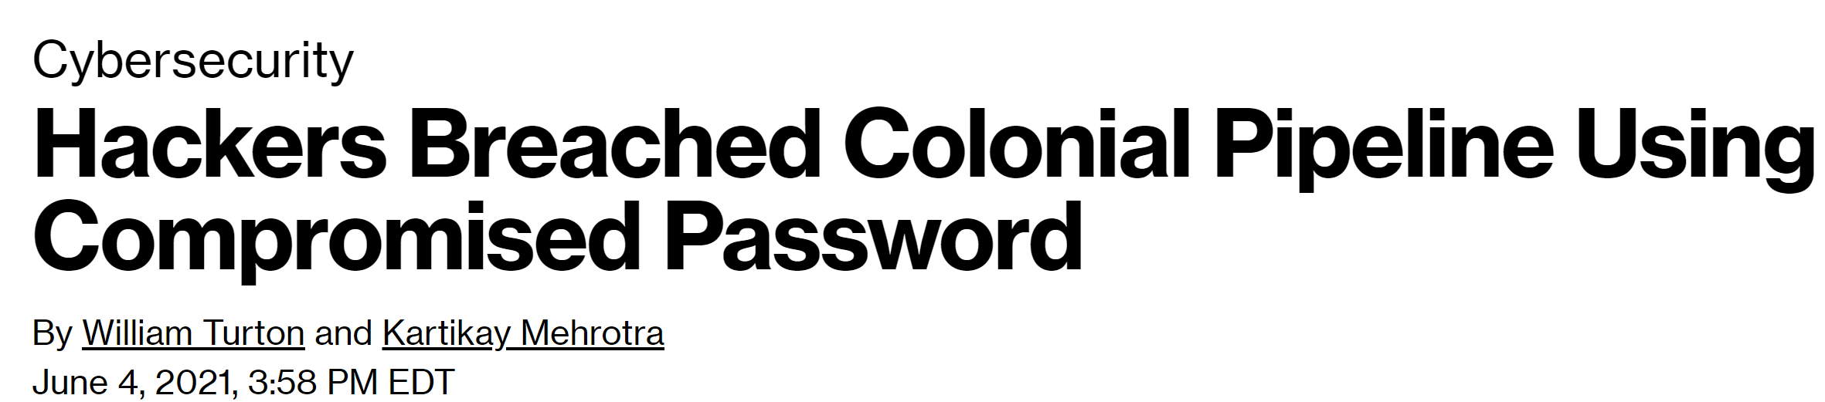
Recent News Headlines on Cyber Attacks

Slide 3
Why Can Computers Be Attacked So Easily?
Airplanes
Not Crashed
Often

Slide 4
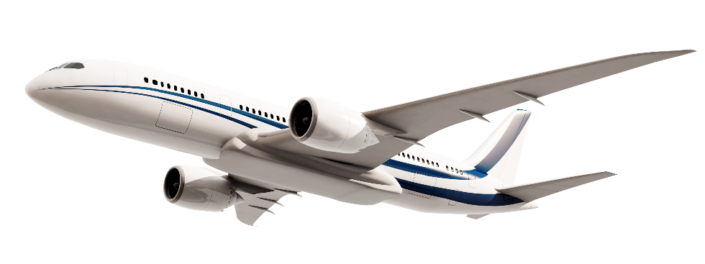
Why Are Airplanes not Crashed So Often?
Years | # Accidents | # Flights in the Air | Rates
2005 – 2008 | 86 | 100.9 millions | 0.000085%
2009 – 2012 | 100 | 110.3 millions | 0.000091%
2013 – 2016 | 65 | 130.2 millions | 0.000050%
2017 – 2020 | 56 | 148.6 millions | 0.000038%
Sources: https://www.statista.com/statistics/564769/airline-industry-number-of-flights/ https://en.wikipedia.org/wiki/List_of_accidents_and_incidents_involving_commercial_aircraft

Slide 5
Aircraft Design
Reliability Design
Hardware
Software
Fault-avoidance
Fault-tolerant
Fault-avoidance
Fault-tolerant
Derating design
sneak circuit analysis
environmental conditions analysis
Redundancy design
Formal development guidelines
Single-version
Multi-version
Human
CRC
Hamming Code
Multiple-voting
Reliability Design
Hardware
Software
Fault-avoidance
Fault-tolerant
Fault-avoidance
Fault-tolerant
Derating design
sneak circuit analysis
environmental conditions analysis
Redundancy design
Formal methods
Single-version
Multi-version
Human
CRC
Hamming Code
Multiple-voting
Wing
Engine
Fault-avoidance
Fault-tolerant
Fault-avoidance
Fault-tolerant
Redundancy design
Formal methods
Single-version
Multi-version
Stabilizer
CRC
Multiple-voting
Hamming Code
Sources: https://www.sciencedirect.com/science/article/pii/S1000936118301948

Slide 6



Cyclic Redundancy Check (CRC)
Alice
Bob
m
m’
0101… 1100
0101… 1000
Pions
Neutrinos
Muons
Cosmic Ray
Air Molecules

Slide 7

Cyclic Redundancy Check (CRC)
Alice
Bob
m
S
m
S
0101… 1100
S
Generate checksum:
S ← CRC(m)
Verify checksum:
CRC(m) ?= S

Slide 8
Cyclic Redundancy Check (CRC)
Alice
Bob
m
S
m
S
0101… 1100
S
1010… 1111
S’
Generate checksum:
S ← CRC(m)
Verify checksum:
CRC(m’) ?= S’
S’ ← CRC(m’)

Slide 9

Message Authentication Code (MAC)
Alice
Bob
m
S
m
S
0101… 1100
S
Generate checksum:
S ← MAC(m, k)
Verify checksum:
MAC(m,k) ?= S

Slide 10
cybersecurity
The essence of reliability: dealing with errors from the natural environment
“intelligent” adversary

Slide 11


Cybersecurity: An Adversarial Discipline
Offenders
Defenders

Slide 12
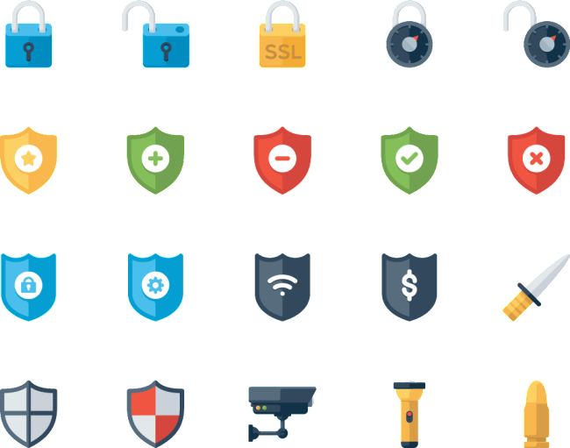
Asymmetry

Slide 13

Asymmetry

Slide 14
Asymmetry

Slide 15
Asymmetry

Slide 16


Asymmetry

Slide 17
Cybersecurity: An Adversarial Discipline
Offenders
Defenders

Slide 18
Who Are the Offenders?
Attackers
Cyber criminals
Insiders
…
State sponsored
Script kiddies
Hacktivists
Offenders

Slide 19
What Are Their Motivations?
Motivations
Political Or Social Gain
Business Competition
Cyberwarfare
Radical Heckerism
Financial Gain
Intellectual Property
Offenders

Slide 20
How Powerful Are They?
Powerfulness
Quantum
Cryptography
…
Automation
AI
Obfuscation
Offenders
Human | Machine
Simple tasks | Sophisticated tasks
Hard to be replicated | Easily replicable
Short lived memory | Long lived memory
Intuition | Brute force
Abstraction | Precision
Creativity | Scalability

Slide 21
Knowledge Defenders Have to Know
Governance
Cryptocurrency
Data Analytics
Defenders
Cyber Insurance
Forensics
Vulnerability
Analysis
Law
Protocol
Analysis
Internet-of-Things
Blockchain
Human
Factors
Fuzzing
Operating Systems
Security
Web
Applied
Cryptography
Network
Security
Emulation
Security
Operations
Game Theory
Trust
Isolation
Cloud
Regulation
Debugging
Risk
Management
Hardware
Security
Information Theory
Access Control
Software
Security
Mobile
Cryptography
Sandboxing
Anonymity
Authentication
Reverse
Engineering
Assurance
Authorization
Firmware
Security
Auditing
Physical Layer Security
Edge
Deception
Privacy
Abuse
Detection
Darknet
Disassembling
Cybercrime
Data Security
Embedded
Desktop
Cyber-physical Systems
Decompiling
Intrusion
Detection
Server
Intrusion
Prevention
Instrumentation
Malware
Analysis
Social
Engineering
Compliance
Ethics

Slide 22
Why Does Cybersecurity Become Harder and Harder?
The dilemma between Isolation and Convenience

Slide 23
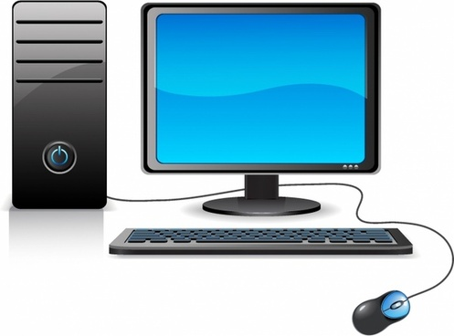










History of Cyber Evolution
Pre-Internet
Internet
Mobile
IoT
ENIAC
1946
Multics
1964
APRAnet
1969
MS-DOS
1981
Windows
1983
TCP/IP & Internet
1983
Web Server
1991
GSM
1982
WiFi
1999
Android
2005
iPhone
2007
IoT
2010
Nest Thermostat
2011
Apple Watch
2015
Trusted
23

Slide 24
History of Cyber Evolution
The Zero Trust Architecture
“Today, Devices should not be trusted by default, even if they are connected to a managed corporate network such as the corporate LAN and even if they were previously verified”
Trusted
Zero Trust
24

Slide 25
Attack Surface
25

Slide 26

Attack Surface

Slide 27























Attack Surface
27

Slide 28
What Have Defenders Been Working on?
Inventing Isolation Primitives
Developing Memory Safe Programming Languages
Formal Verification
AI for Cybersecurity

Slide 29
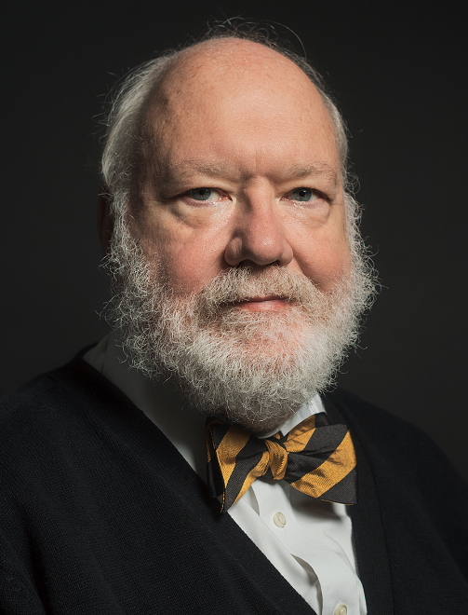
Direction I: Isolation
“The only system which is truly secure is one which is switched off and unplugged, locked in a titanium lined safe, buried in a concrete bunker, and is surrounded by nerve gas and very highly paid armed guards.”
Gene Spafford
Professor of Computer Science, Purdue University
The dilemma between Isolation and Convenience

Slide 30
Direction I: Isolation
Pre-Internet
Internet
Mobile
IoT
ENIAC
1946
Multics
1964
APRAnet
1969
MS-DOS
1981
Windows
1983
TCP/IP & Internet
1983
Web Server
1991
GSM
1982
WiFi
1999
Android
2005
iPhone
2007
IoT
2010
Nest Thermostat
2011
Apple Watch
2015
Virtual Memory
1959
Ring Protection
1964
Virtualization
1972
HTTPS
1994
Arm TrustZone
2004
Intel VT
2005
AMD-V
2006
Intel Secure Guard Extension (SGX)
2014
Intel Memory Protection Extensions (MPX)
2014
AMD Secure Encrypted Virtualization (SEV)
2016
Intel Total Memory Encryption (TME)
?
Intel Multi-Key TME (MKTME)
?

Slide 31
Today’s Isolation
Computer
Computer
SGX, Encryption
Apps
Apps
SGX, Encryption
Apps
Apps
Ring, Virtual Memory,
Operating System
Ring, Virtual Memory,
Operating System
MPX, Intel VT,
AMD-V, SEV
Virtual Machine Monitor
MPX, Intel VT,
AMD-V, SEV
Virtual Machine Monitor
SSL/TLS
SSL/TLS
Physical Isolation
Hardware
Physical Isolation
Hardware

Slide 32

Direction II: Memory Safe Programming Languages
Memory Unsafe Languages (C/C++)
Return Function
Data
Base Pointer
→ Buffer Overflow
Data
Data
Data
→ Control Flow Hijacking

Slide 33
Arm Races in Buffer Overflow Attacks and Defense
Code Injection Attacks
Code Reuse Attacks
Morris Worm
1988
Code Injection
AlephOne
1996
Return-into-libc Solar Designer
1997
Borrowed Code Chunk Krahmer
2005
ROP Shacham
CCS’07
Q:ROP Schwartz
et al
SEC’11
JIT-ROP Snow
et al
SP’13
BROP
Bittau
et al
SP’14
DOP
Hu
et al
SP’16
Address Oblivious Code Reuse
Rudd et al
NDSS’17
KEPLER
Wu et al
SEC’19
We need memory safe programming languages
Canary
Cowan
et al
SEC’98
DEP/NX
Linux
Microsoft
01-04
ASLR
PAX
01-02
CFI
Abadi
et al
CCS’05
STIR
Wartel
et al
CCS’12
BinCFI
Zhang
et al
SEC’13
Forward-edge CFI
Tice
et al
SEC’14
VS-CFG
Microsoft
2015
Runtime ASLR
Lu et al
NDSS’16
CET
INTEL
17
PAC
ARM
17
xMP
Proskurin et al
S&P’20
33

Slide 34
History of Programming Language Development
Plankalkül
1944
Fortran
1957
PASCAL
1970
C++
1983
Objective-C
1983
Python
1991
Visual Basic
1991
C#
2000
Scala
2003
Groovy
2003
Rust
2010
Assembly
1949
Basic
1964
C
1972
SQL
1972
Perl
1987
Haskell
1990
Ruby
1993
Java
1995
PHP
1995
JavaScript
1995
Go
2009
Swift
2014

Slide 35
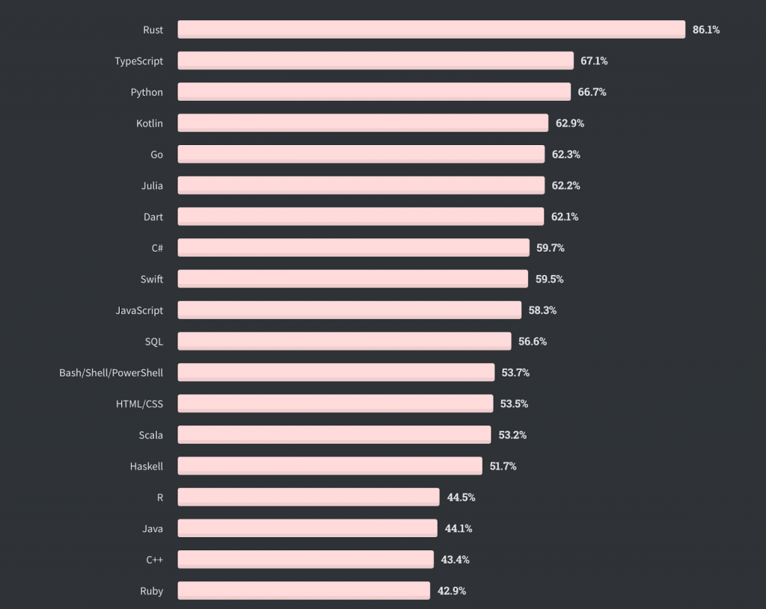
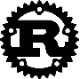
Rust Is the Most Loved Programming Language
Source: https://thenewstack.io/rust-by-the-numbers-the-rust-programming-language-in-2021/

Slide 36






Companies Use Rust in Production
Source: https://serokell.io/blog/rust-companies

Slide 37
Direction III: Formal Verification
Reliability Design
Hardware
Software
Fault-avoidance
Fault-tolerant
Fault-avoidance
Fault-tolerant
Derating design
sneak circuit analysis
environmental conditions analysis
Redundancy design
Formal development guidelines
Single-version
Multi-version
Human
CRC
Hamming Code
Multiple-voting
Reliability Design
Hardware
Software
Fault-avoidance
Fault-tolerant
Fault-avoidance
Fault-tolerant
Derating design
sneak circuit analysis
environmental conditions analysis
Redundancy design
Formal methods
Single-version
Multi-version
Human
CRC
Hamming Code
Multiple-voting
Sources: https://www.sciencedirect.com/science/article/pii/S1000936118301948

Slide 38
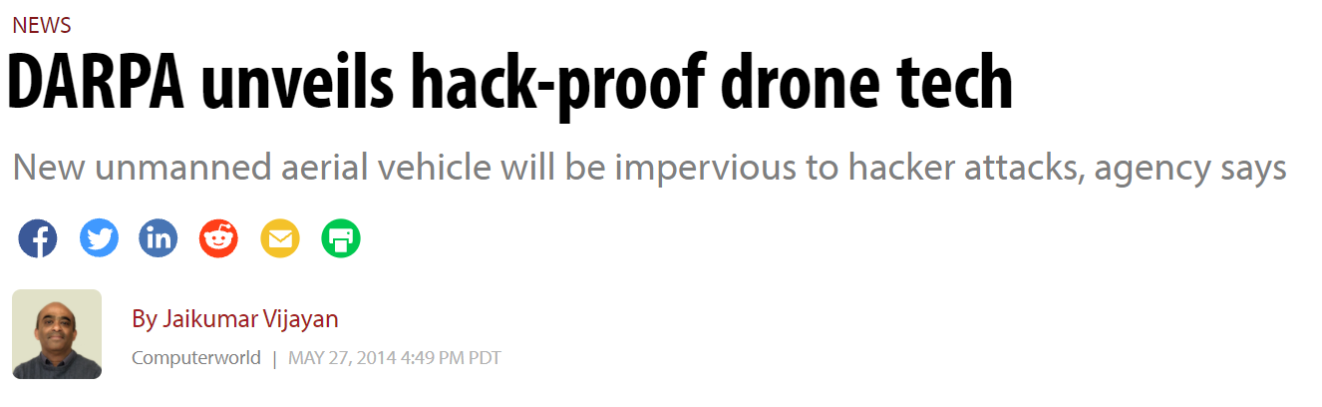
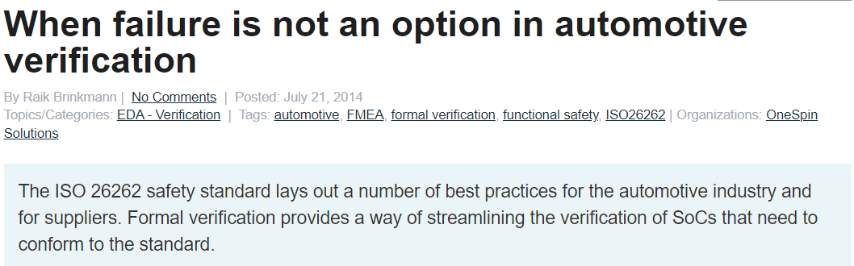
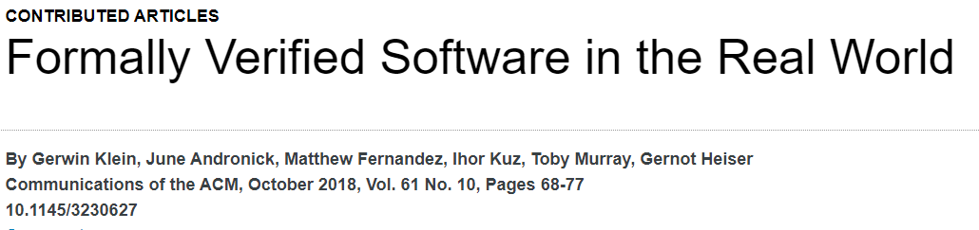
Direction III: Formal Verification

Slide 39
Direction III: Formal Verification
Difficulty(Proving Security)
>>
Difficulty(Finding a Vulnerability)

Slide 40
Direction III: Formal Verification – Recent Progress from Systems Community
seL4: Formal verification of micro-kernels
SOSP’09
Verify computations with states
SOSP’13
Hyperkernel
SOSP’17
Verifying a high-performance crash-safe system
SOSP’17
Komodo
SOSP’17
Serval
SOSP’19
Verifying concurrent, crash-safe system with Perennial
SOSP’19
Verifying the AtomFS file system
SOSP’19
Verifying software network functions
SOSP’19
Aragog OSDI’20
Storage and Distributed Systems
OSDI’20
1
1
1
1
1
3
4
4
5
Execute-Verify Replication for Multi-Core Servers
OSDI’12
Ironclad Apps
OSDI’14
Verification of File Systems
OSDI’16
Nickel
OSDI’18
Verifying concurrent software using movers in CSPEC
OSDI’18
Proving confidentiality in a file system using DiskSec
OSDI’18
Proving the correct execution of concurrent in zero-knowledge
OSDI’18
Applying formal methods to just-in-time compilers in the Linux kernel
OSDI’20
Cobra
OSDI’20
Determining Crash Behavior
OSDI’20
Notes:
GoJournal: a verified, concurrent, crash-safe journaling system OSDI 21
OSDI 20 Luke Nelson, Jacob Van Geffen, Emina Torlak, Xi Wang: Specification and verification in the field: Applying formal methods to BPF just-in-time compilers in the Linux kernel. 41-61
Cheng Tan, Changgeng Zhao, Shuai Mu, Michael Walfish: Cobra: Making Transactional Key-Value Stores Verifiably Serializable. 63-80
Yun-Sheng Chang, Yao Hsiao, Tzu-Chi Lin, Che-Wei Tsao, Chun-Feng Wu, Yuan-Hao Chang, Hsiang-Shang Ko, Yu-Fang Chen: Determinizing Crash Behavior with a Verified Snapshot-Consistent Flash Translation Layer. 81-97
Travis Hance, Andrea Lattuada, Chris Hawblitzel, Jon Howell, Rob Johnson, Bryan Parno: Storage Systems are Distributed Systems (So Verify Them That Way!). 99-115 Nofel Yaseen, Behnaz Arzani, Ryan Beckett, Selim Ciraci, Vincent Liu: Aragog: Scalable Runtime Verification of Shardable Networked Systems. 701-718
SOSP 19
Luke Nelson, James Bornholt, Ronghui Gu, Andrew Baumann, Emina Torlak, Xi Wang: Scaling symbolic evaluation for automated verification of systems code with Serval. 225-242
Tej Chajed, Joseph Tassarotti, M. Frans Kaashoek, Nickolai Zeldovich: Verifying concurrent, crash-safe systems with Perennial. 243-258
Mo Zou, Haoran Ding, Dong Du, Ming Fu, Ronghui Gu, Haibo Chen: Using concurrent relational logic with helpers for verifying the AtomFS file system. 259-274
Arseniy Zaostrovnykh, Solal Pirelli, Rishabh R. Iyer, Matteo Rizzo, Luis Pedrosa, Katerina J. Argyraki, George Candea: Verifying software network functions with no verification expertise. 275-290
Haojun Ma, Aman Goel, Jean-Baptiste Jeannin, Manos Kapritsos, Baris Kasikci, Karem A. Sakallah: I4: incremental inference of inductive invariants for verification of distributed protocols. 370-384
OSDI 18
Helgi Sigurbjarnarson, Luke Nelson, Bruno Castro-Karney, James Bornholt, Emina Torlak, Xi Wang: Nickel: A Framework for Design and Verification of Information Flow Control Systems. 287-305
Tej Chajed, M. Frans Kaashoek, Butler W. Lampson, Nickolai Zeldovich: Verifying concurrent software using movers in CSPEC. 306-322
Atalay Mert Ileri, Tej Chajed, Adam Chlipala, M. Frans Kaashoek, Nickolai Zeldovich: Proving confidentiality in a file system using DiskSec. 323-338
Srinath T. V. Setty, Sebastian Angel, Trinabh Gupta, Jonathan Lee: Proving the correct execution of concurrent services in zero-knowledge. 339-356
SOSP 17
Luke Nelson, Helgi Sigurbjarnarson, Kaiyuan Zhang, Dylan Johnson, James Bornholt, Emina Torlak, Xi Wang: Hyperkernel: Push-Button Verification of an OS Kernel. 252-269
Haogang Chen, Tej Chajed, Alex Konradi, Stephanie Wang, Atalay Mert Ileri, Adam Chlipala, M. Frans Kaashoek, Nickolai Zeldovich: Verifying a high-performance crash-safe file system using a tree specification. 270-286
Andrew Ferraiuolo, Andrew Baumann, Chris Hawblitzel, Bryan Parno: Komodo: Using verification to disentangle secure-enclave hardware from software. 287-305
OSDI 16
Helgi Sigurbjarnarson, James Bornholt, Emina Torlak, Xi Wang: Push-Button Verification of File Systems via Crash Refinement. 1-16
OSDI 14
Chris Hawblitzel, Jon Howell, Jacob R. Lorch, Arjun Narayan, Bryan Parno, Danfeng Zhang, Brian Zill: Ironclad Apps: End-to-End Security via Automated Full-System Verification. 165-181
SOSP 13
Benjamin Braun, Ariel J. Feldman, Zuocheng Ren, Srinath T. V. Setty, Andrew J. Blumberg, Michael Walfish: Verifying computations with state. 341-357
OSDI 12
Manos Kapritsos, Yang Wang, Vivien Quéma, Allen Clement, Lorenzo Alvisi, Mike Dahlin: All about Eve: Execute-Verify Replication for Multi-Core Servers. 237-250
OSDI 10
0

Slide 41

Direction IV: AI For Cybersecurity
Brute force
Precision
Scalability
^{Automatic data analytics}
Automatic threat identification
^{Automated risk predication}
^{Automated signature derivation}
^{Automated response}
…

Slide 42
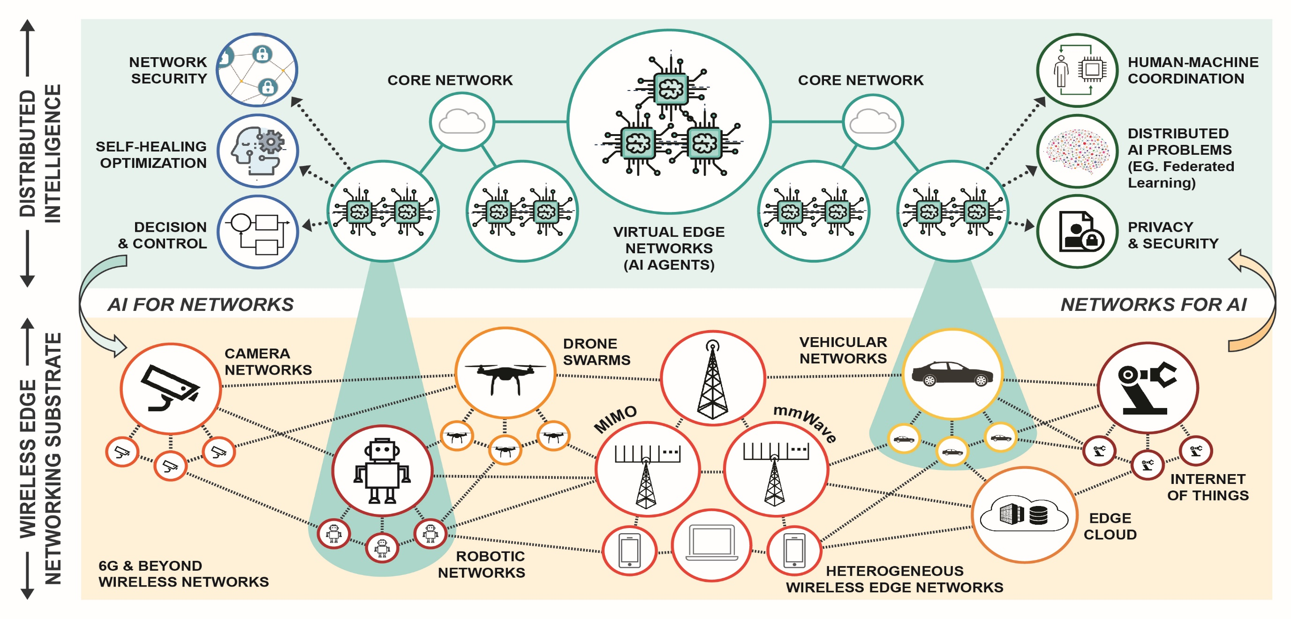
The AI-Edge Institute at OSU
https://aiedge.osu.edu/

Slide 43
The Non-Technical Aspects

Slide 44
Cybersecurity Laws and Regulations
Computer Fraud and Abuse Act (CFAA)
1986
Federal Information Security Management Act (FISMA)
2002
The European Union’s General Data Protection Regulation (GDPR)
2018
Computer Fraud and Abuse Act (CFAA)
1986
Electronic Communications Privacy Act (ECPA)
1986
Computer Security Act
1987
Computer Misuse Act
1990
California Consumer Privacy Act (CCPA)
2020
Attribution
Jurisdiction

Slide 45
Thank You
Questions and Comments:
zlin@cse.ohio-state.edu

